Slide 1
Deblurring and Enhancing Astrophotographs Using PSF Based Digital Image Processing
Group 19

Slide 2
Group 19
Name | Roll no.
Tarjani Patel | AU2340045
Purvish Parekh | AU2340128
Vrushti Patel | AU2340131
Ansh Rathva | AU2340208
Hetanshu Parmar | AU2340254

Slide 3
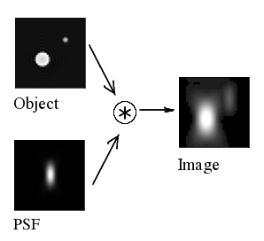
Introduction
When the light passes through an optical telescope, its intensity distribution spreads out because of the diffraction effects, giving us a blurred pattern described by the Point Spread function (PSF).
PSF removal required to undo distortion (deconvolution)
Dataset used: Hubble Legacy Archive Level 3 ( .FITS)
Source: https://en.wikipedia.org/wiki/Point_spread_function

Slide 4
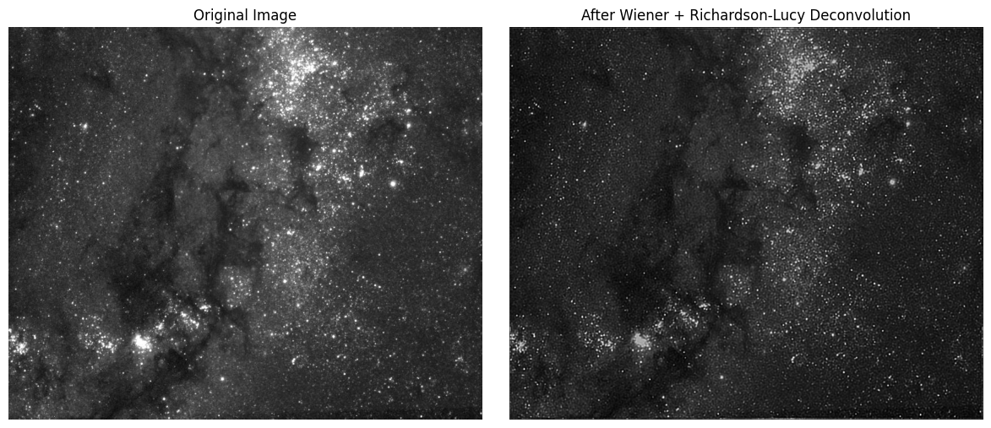
Conclusion of Work Done before Mid-sem
Used Wiener Filter
Applied Richardson-Lucy deconvolution with ideal Gaussian PSF
Used pre-processed data

Slide 5
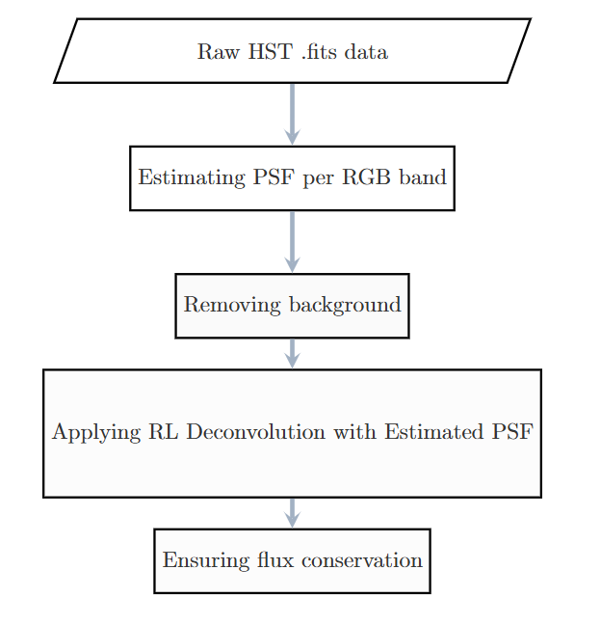
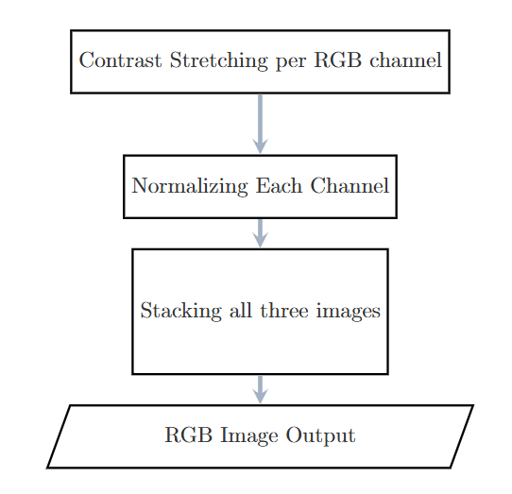
Updated Methodology
PSF Estimation
RGB Reconstruction
Richardson-Lucy deconvolution as a general tool for combining images with different signal-to-noise ratios: a fluorescence microscopy application. (2014). *ChemPhysChem, 15*(5), 761–767. [https://doi.org/10.1002/cphc.201300831](https://doi.org/10.1002/cphc.201300831) ([pmc.ncbi.nlm.nih.gov][1])
https://www.isid.ac.in/~deepayan/SC2010/project-sub/RLA/report.pdf

Slide 6
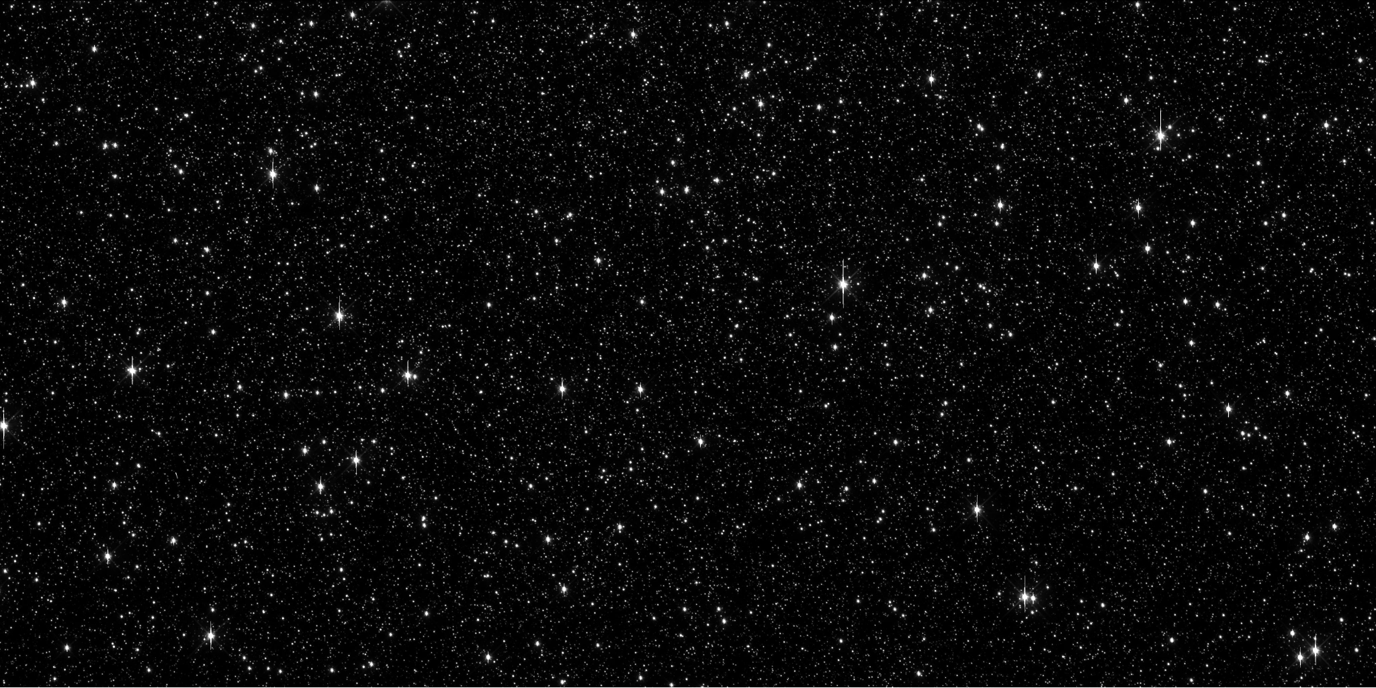
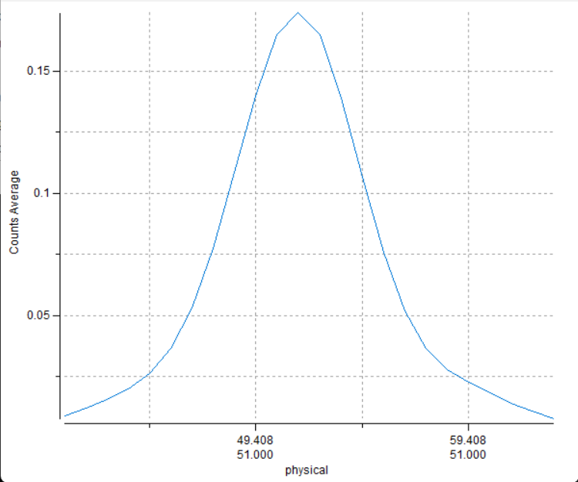
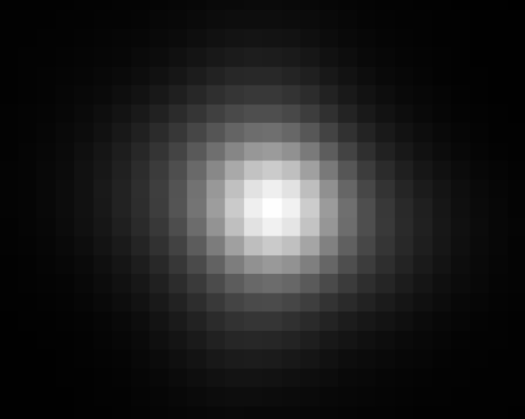
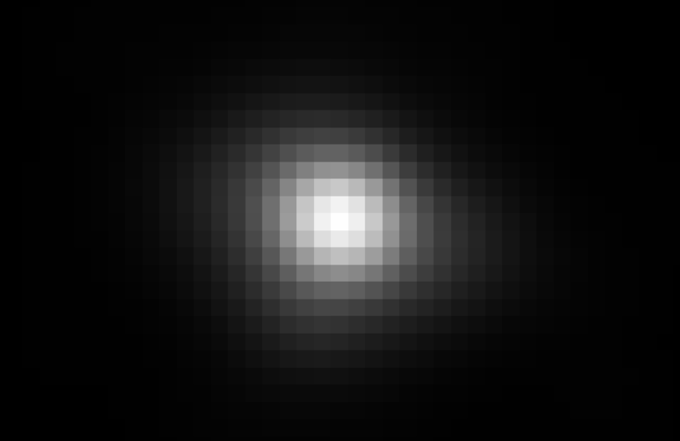
Estimating Instrument Based PSF
Source: https://mast.stsci.edu/portal/Mashup/Clients/Mast/Portal.html
Source: SAOimageDS9

Slide 7
Estimation and Modeling of PSF
Detect and extract the star
Removing background from fixed sized stamp
Stacking many normalized, centered stamps
Fit into 2D Gaussian PSF + Estimating a average PSF based on analysed PSFs.
Align PSF to a bright star stamp

Slide 8
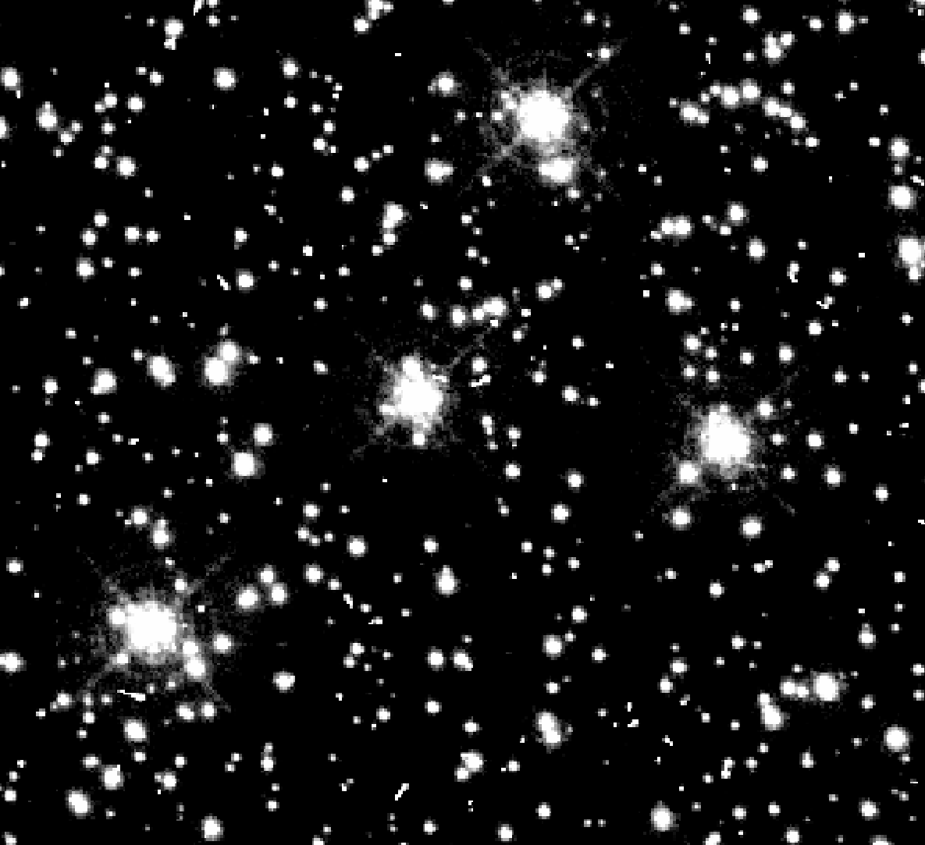
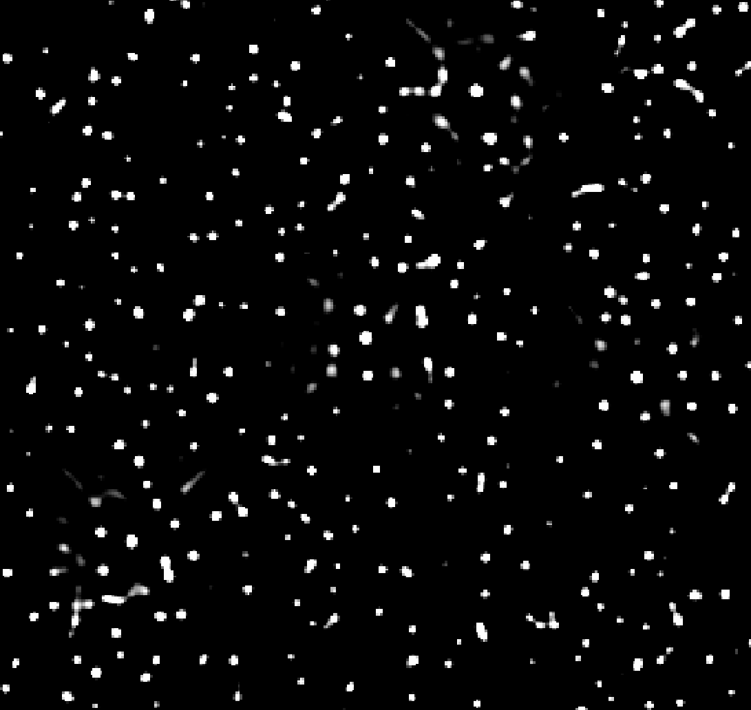
Results

Slide 9
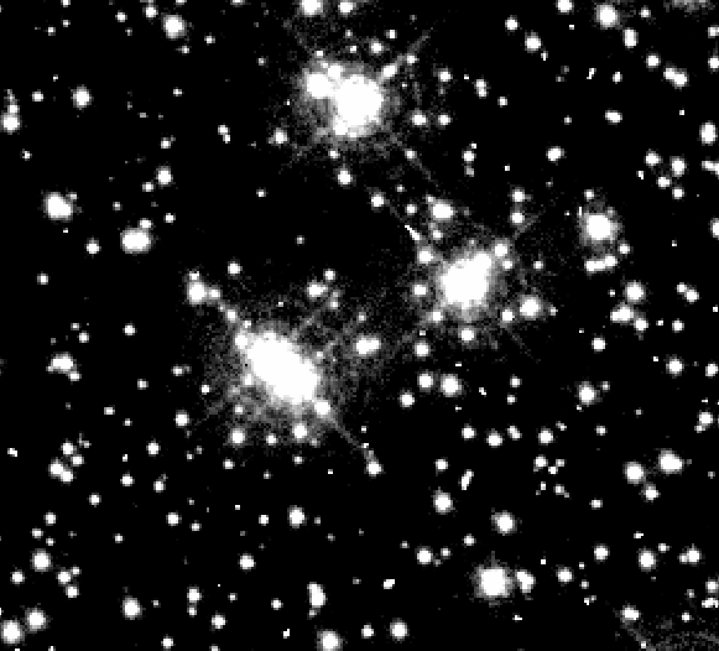
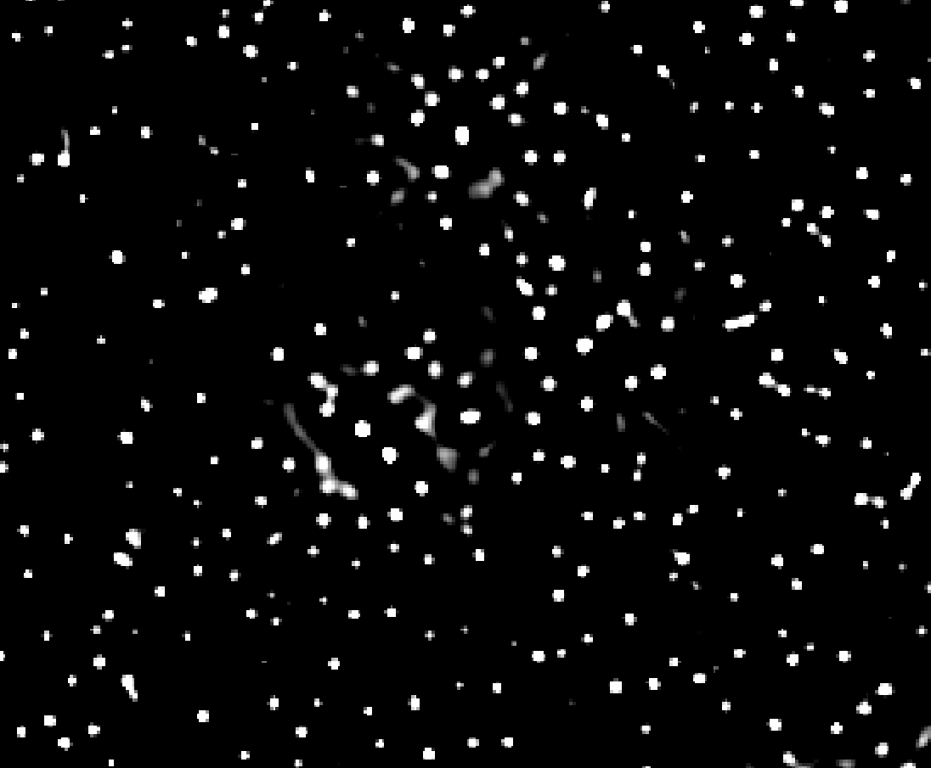
Results

Slide 10
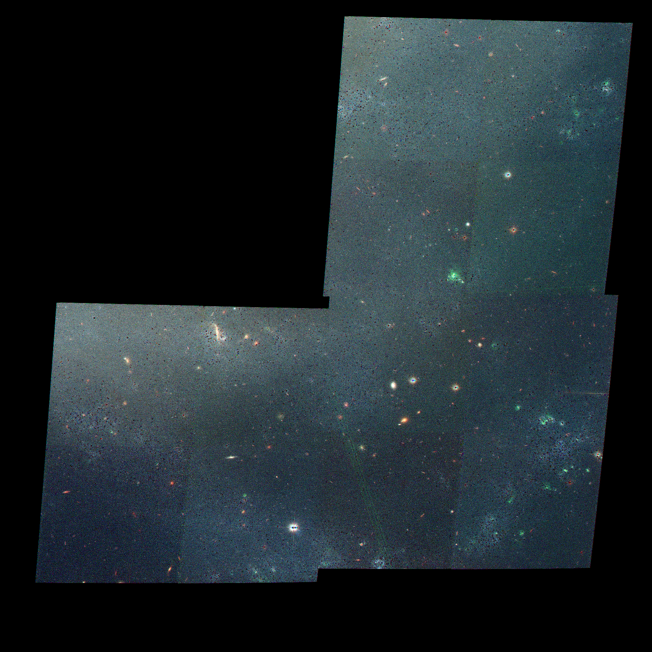
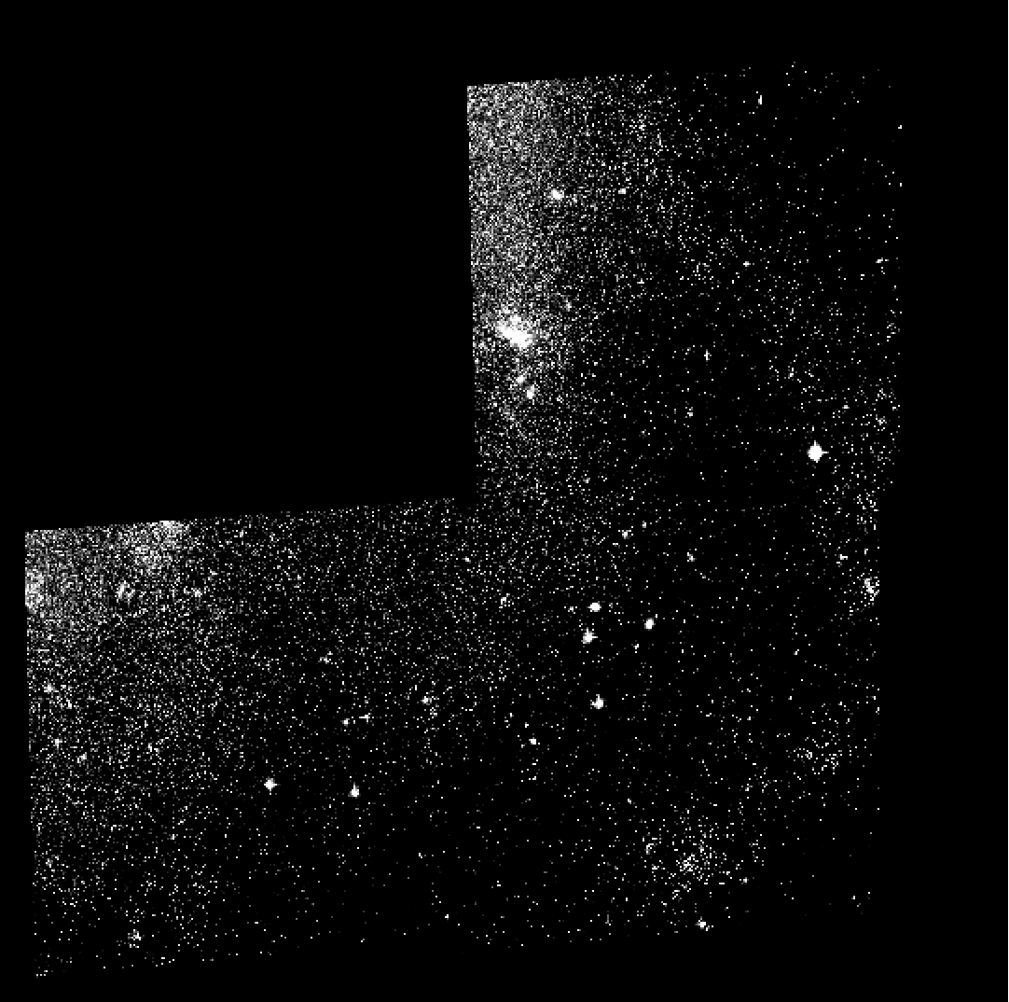
Results: Color Image

Slide 11
Conclusion
Implemented instrument based PSF trained on multiple level 1 FITS
Provides better output quality as compared to Ideal Gaussian PSF
Deconvolution recovers sharpness while preserving flux (median flux ratio = 0.982)
Better image fidelity due to flux conservation and no loss of data

Slide 12
References
POINT SPREAD FUNCTION (PSF). (n.d.). Amateur Telescope Optics. Retrieved from https://www.telescope-optics.net/diffraction_image.html
WFC3-ISR-2022-05: Instrument Science Report. (2022). Space Telescope Science Institute. Retrieved from https://www.stsci.edu/files/live/sites/www/files/home/hst/instrumentation/wfc3/documentation/instrument-science-reports-isrs/_documents/2022/WFC3-ISR-2022-05.pdf
STScI. (n.d.). Point spread function (PSF). Space Telescope Science Institute. Retrieved from https://www.stsci.edu/hst/instrumentation/wfc3/data-analysis/psf
Richardson-Lucy deconvolution as a general tool for combining images with different signal-to-noise ratios: a fluorescence microscopy application. (2014). *ChemPhysChem, 15*(5), 761–767. [https://doi.org/10.1002/cphc.201300831](https://doi.org/10.1002/cphc.201300831) ([pmc.ncbi.nlm.nih.gov][1])
NASA / Science. (2024). PASP article. Retrieved from https://science.nasa.gov/wp-content/uploads/2024/08/draft-pasp-article.pdf
STScI / JWST documentation. (n.d.). James Webb Space Telescope — Near Infrared Camera (NIRCam). Retrieved from https://jwst-docs.stsci.edu/jwst-near-infrared-camera#gsc.tab=0
Optics Express, 32(16), Retrieved from https://opg.optica.org/oe/fulltext.cfm?uri=oe-32-16-27278
“STScI | Mikulski Archive for Space Telescopes (MAST) Portal.” Accessed at https://mast.stsci.edu/portal/Mashup/Clients/Mast/Portal.html.
“PSF | STScI.” Accessed at https://www.stsci.edu/hst/instrumentation/wfc3/data-analysis/psf.

Slide 13
Thank you

